Slide 1
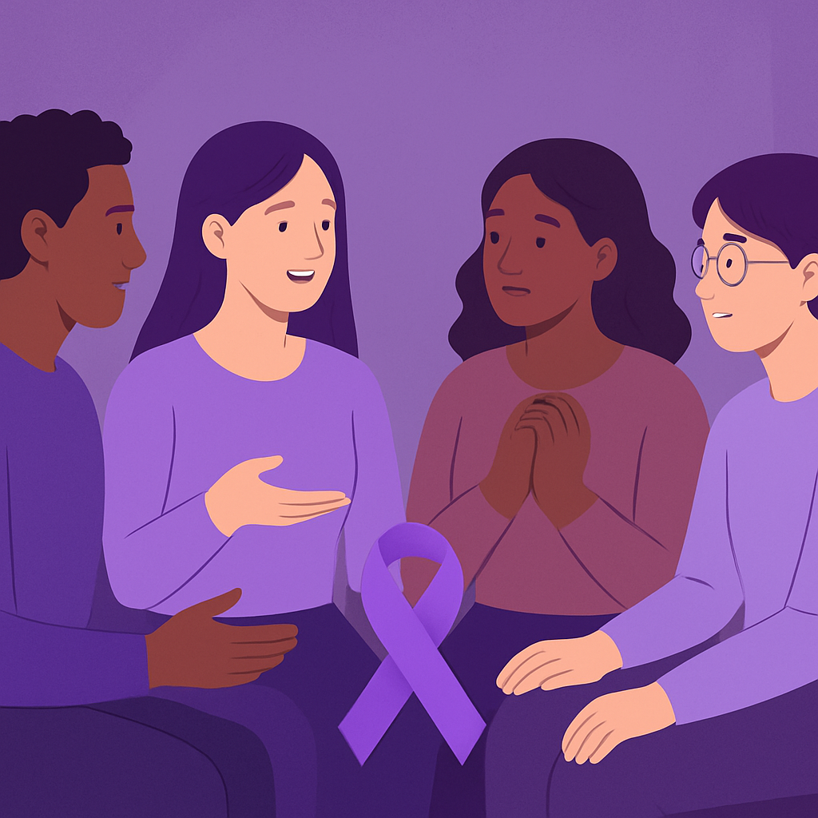

SUPPORTING VICTIMS OF VIOLENCE AND ABUSE
VEA: Violence Ending
Agent
Gender-Based Violence Chat Support

Slide 2

The Problem
Many individuals experience gender-based violence world wide. Survivors often face:
Lack of accessible, safe channels for guidance
Isolation from family, peers, friends, or a social network
Not knowing who to reach out to or receiving immediate support
Existing support systems are often intimidating, and have gaps in accessibility, anonymity, and immediate response. Many victims may never seek help due to fear, shame, or accessibility barriers.

Slide 3
Our Solution?
VEA: Violence Ending Agent

Slide 4
VEA
Violence Ending Agent
VEA is a digital platform designed to provide a safe, confidential, and accessible assistance to individuals experiencing Gender-Based Violence (GBV).
This Application offers trauma-informed emotional support, guidance, and clear strategies to help individuals, while ensuring that users remain in control of their choices throughout the interaction.

Slide 5


Core Features
24/7 Support Chatbot - safe, anonymous help anytime
Risk Assessment Tool - quick GBV danger-level check
Crisis Pathway Guide
Professional Referral - connect to counsellors & services
Red-flag detection system
Conversation History - secure, optional saved chat
Help button to notify closeby authorities, professionals, and support systems

Slide 6
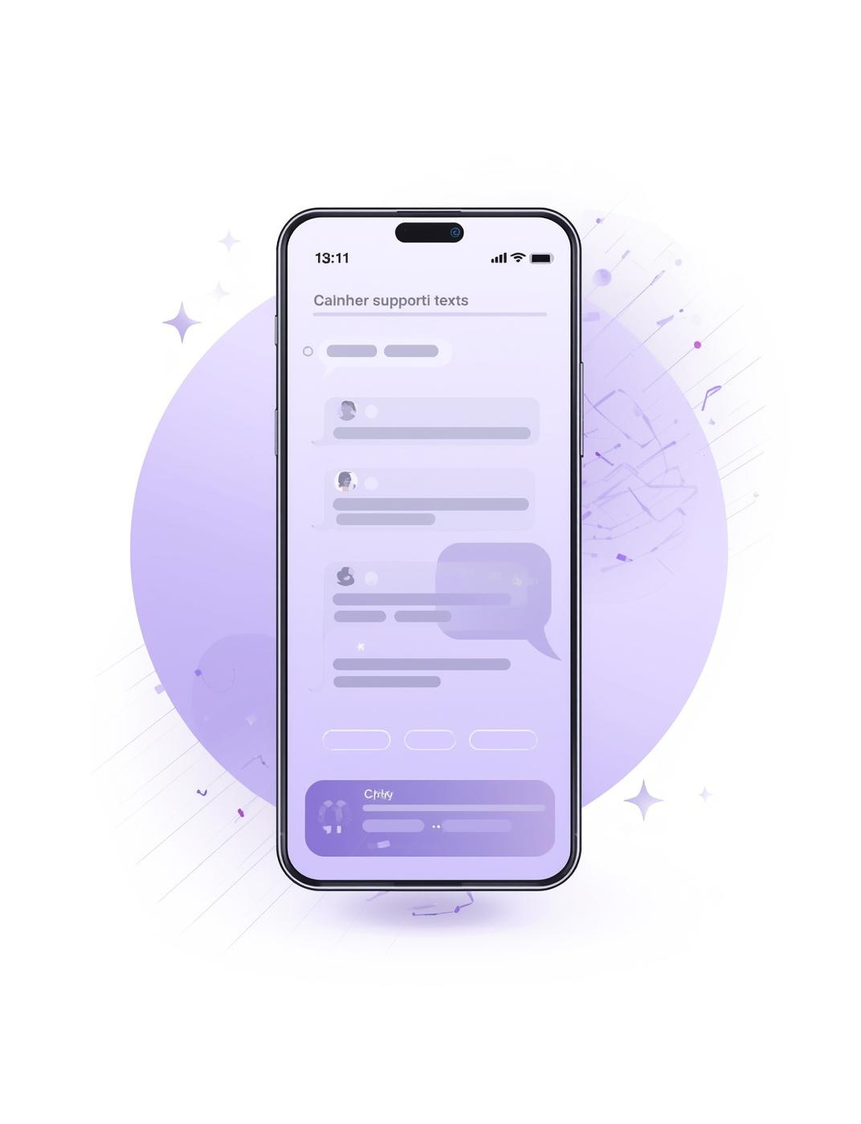
Chatbot Support
vChatbots provide immediate assistance and guidance for individuals seeking help with GBV-related issues in a safe space.

Slide 7

Reporting Help
Seeking assistance is crucial; trained professionals can provide support and guidance for those affected by GBV.

Slide 8

Red Flag Detection System
The system intelligently identifies warning signs of potential abuse by analysing user messages for concerning patterns, keywords, and emotional cues. When a red flag is detected, the platform gently alerts the user, offers supportive guidance, and suggests safe next steps.

Slide 9

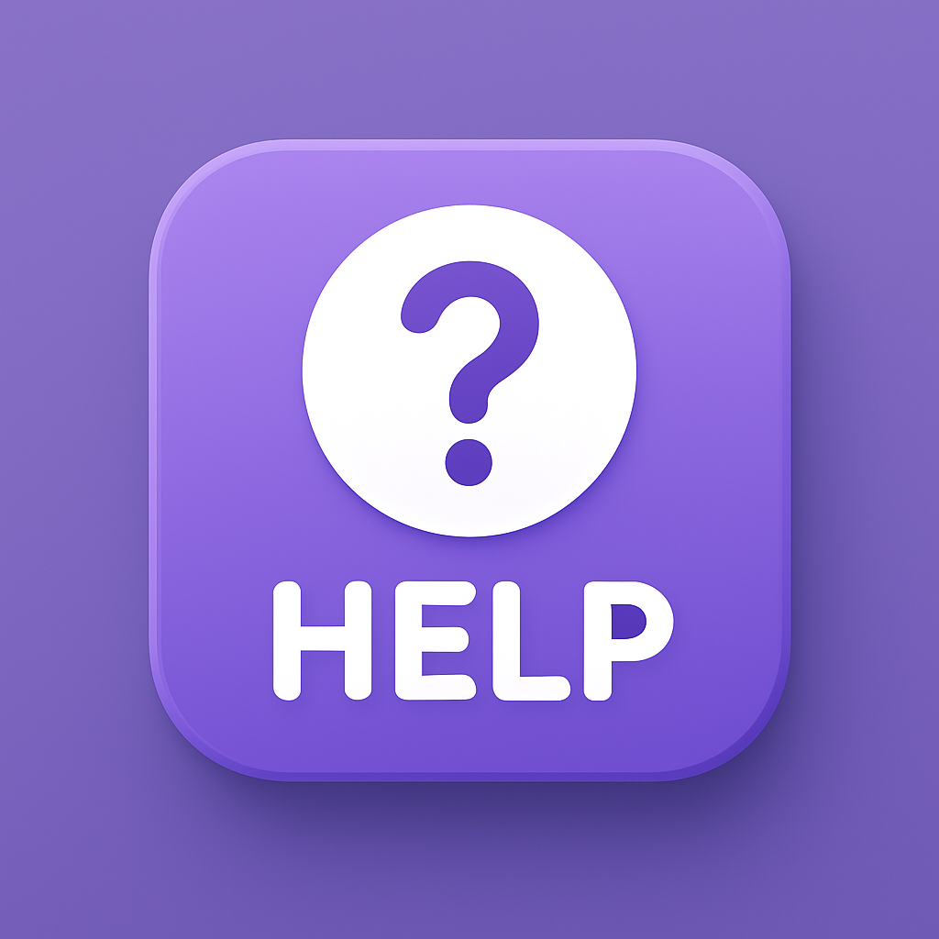
Immediate Help Access
The Help Button gives users instant access to professional support when they need it most. With a single click, users can connect with trained professionals or access guided resources, ensuring they never feel alone.

Slide 10
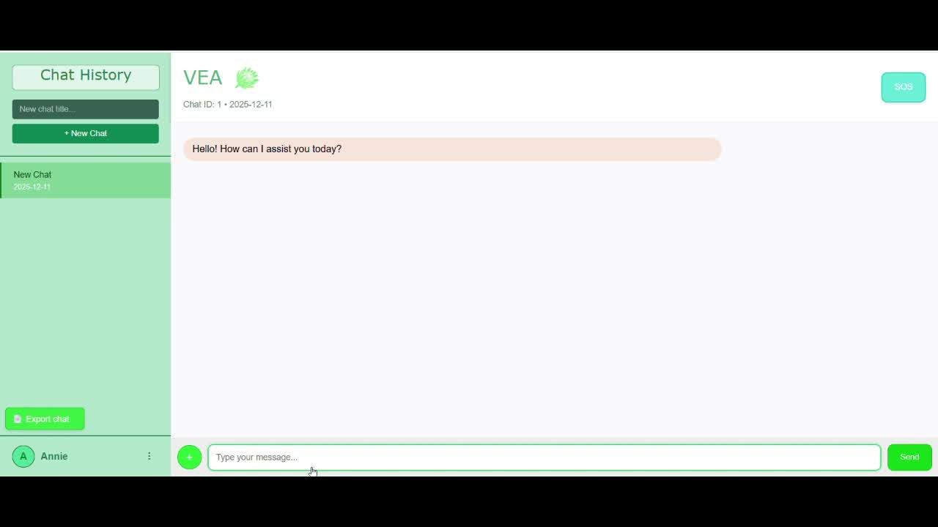

Demo Video

Slide 11
Tech Deep Dive

Slide 12
Architecture
Our AI GBV Support Chatbot is designed for safe, real-time assistance:
Frontend (React + Tailwind CSS): User-friendly chat interface, file uploads, and Help button for immediate support.
Backend (Flask API): Handles user messages, detects red-flag / crisis keywords, and communicates with the AI engine.
AI Engine (GPT-based): Provides empathetic responses, red-flag detection, and professional support guidance.
Session Memory: Maintains chat context and professional support mode without a database.
Alerts / Help Button: Triggers a modal to confirm contacting trained support

Slide 13
Flow
Flow:User sends a message → Frontend captures input.
Backend checks for crisis keywords → triggers support if needed.
GPT generates empathetic response → sent back to frontend.
Chat history stored in DB → accessible for analytics & reporting.
User → Frontend → Backend → AI Engine → Backend → Frontend → Use

Slide 14
Tech Stack
Frontend: React, Tailwind CSS, HTML/CSS
Backend: Python, Flask
AI: Gemini model
Utilities: jsPDF for exporting chat history, session memory for chat context
Deployment: Local or cloud server (no database required)
Git Version Control

Slide 15
Meeting the Team
Nooriya – Co-Team Lead & Designer
Jawahier – Co-Team Lead & Frontend Lead
Rashaad [Last Name] – Backend & AI Specialist
Nikita Martin – Backend & Frontend Developer

Slide 16
We’ve created a safe, responsive, and empathetic digital assistant for individuals affected by GBV. Our solution combines immediate chatbot guidance, red flag detection, and professional support access, providing users with timely help and peace of mind.
“In moments of crisis, immediate support can change lives and empower those affected.”
EMPOWERMENT

Slide 17
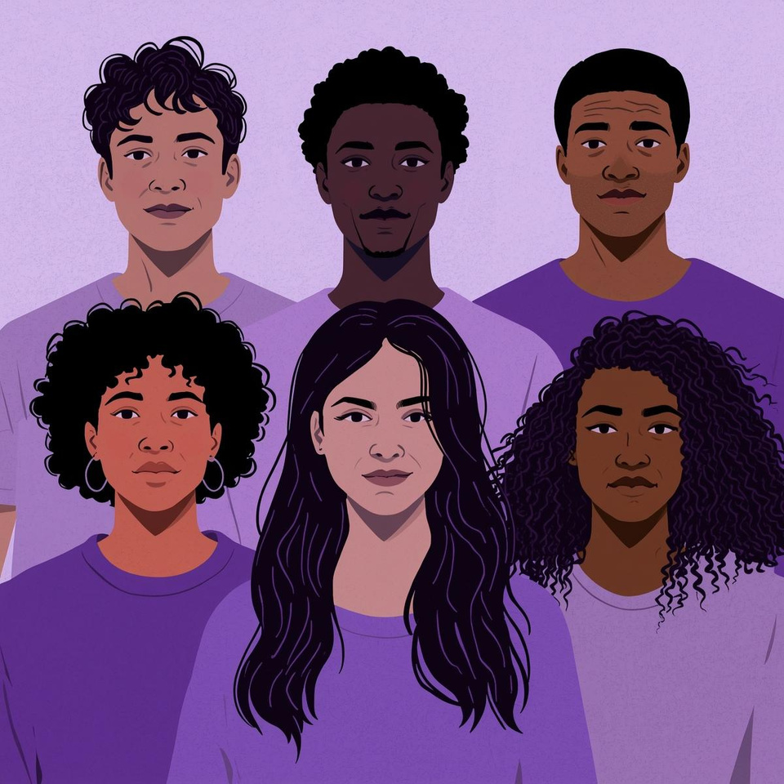
Thank You!
EMPOWERMENT

